Slide 1
SRP Thermal Mass
Courtney Hiatt, Aaron Espinoza, Janelle Peña, Steven Galloway, Maciej Ziomber
Notes:
Janelle
Hook for the audience
Population size
Storytelling vs telling a story
Call on someone I know. Ask them the question… What is one resource every single person and living creature needs to survive? Ans… Water. What is something that almost everyone uses every single day?.... Electricity…. Both water and electricity are a We need both to live in these modern days. Our team has created a system that allows us to do both. We have designed a hydro power plant using waste water from old uranium mines to generate and provide electricity to those without power. The team that has accomplished this goal is myself Janelle Peña…..

Slide 2
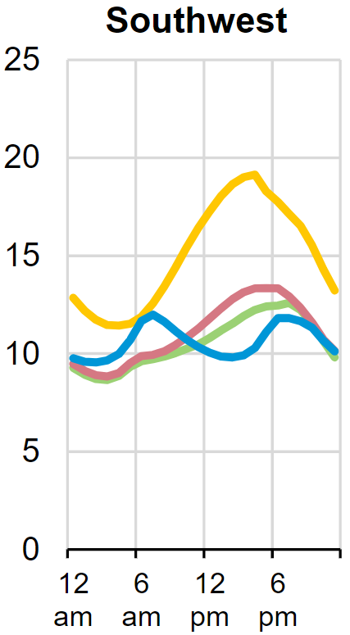
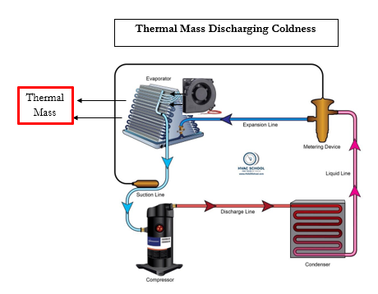
Project Description
2
Janelle
Fig. 1 Average hourly electricity load by region [20]
The peak of the demand has the highest cost
Using more energy storage in the minimum demand times and releasing that energy during the peak demand is our goal
Sponsored by Salt River Project (SRP)
Important because it will become vital for renewable energy to be reliable and viable
Individual home level
[20] Hourly electricity consumption varies throughout the day and across seasons - U.S. Energy Information Administration (EIA), https://www.eia.gov/todayinenergy/detail.php?id=42915 (accessed Feb. 5, 2024).
Notes:
The overall pic, heat goes in heat goes out

Slide 3
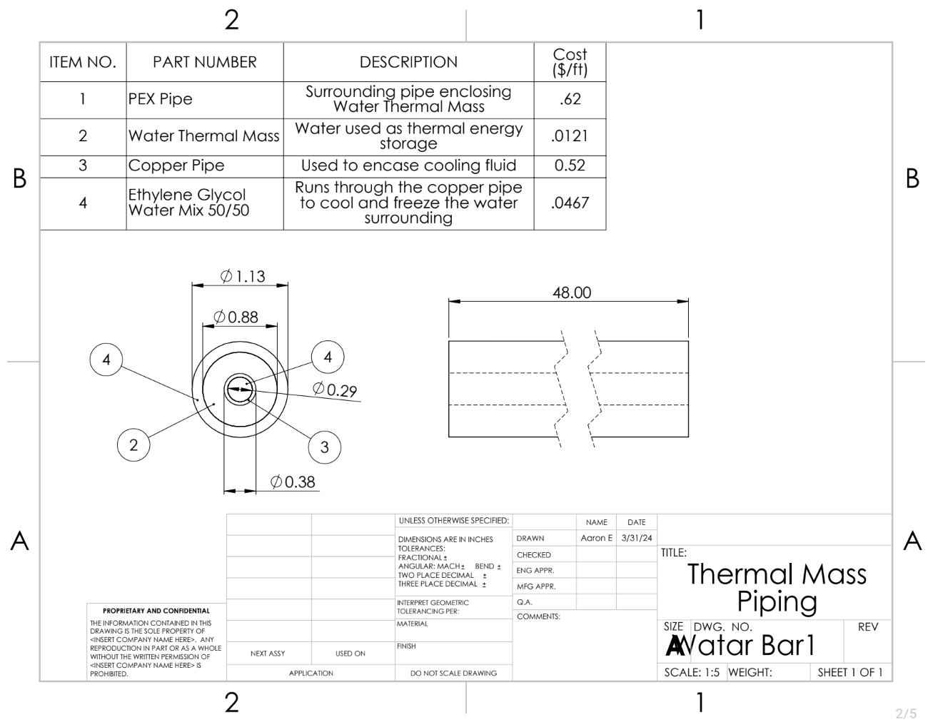
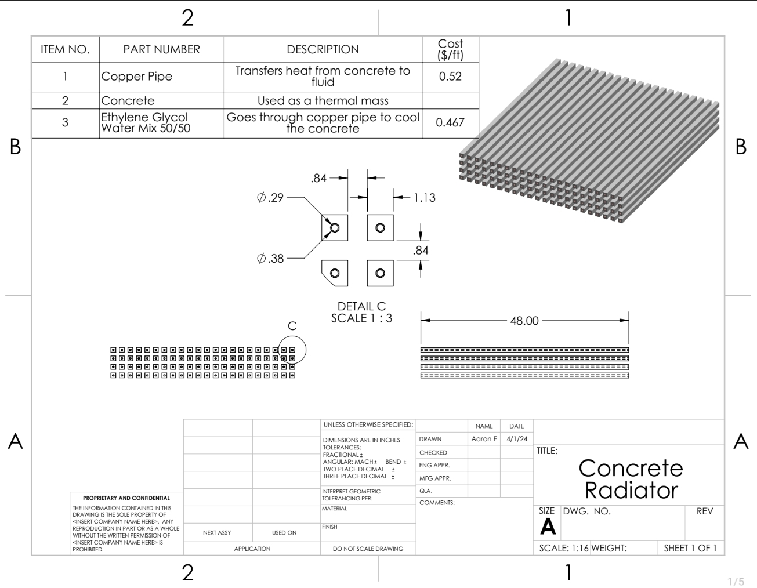
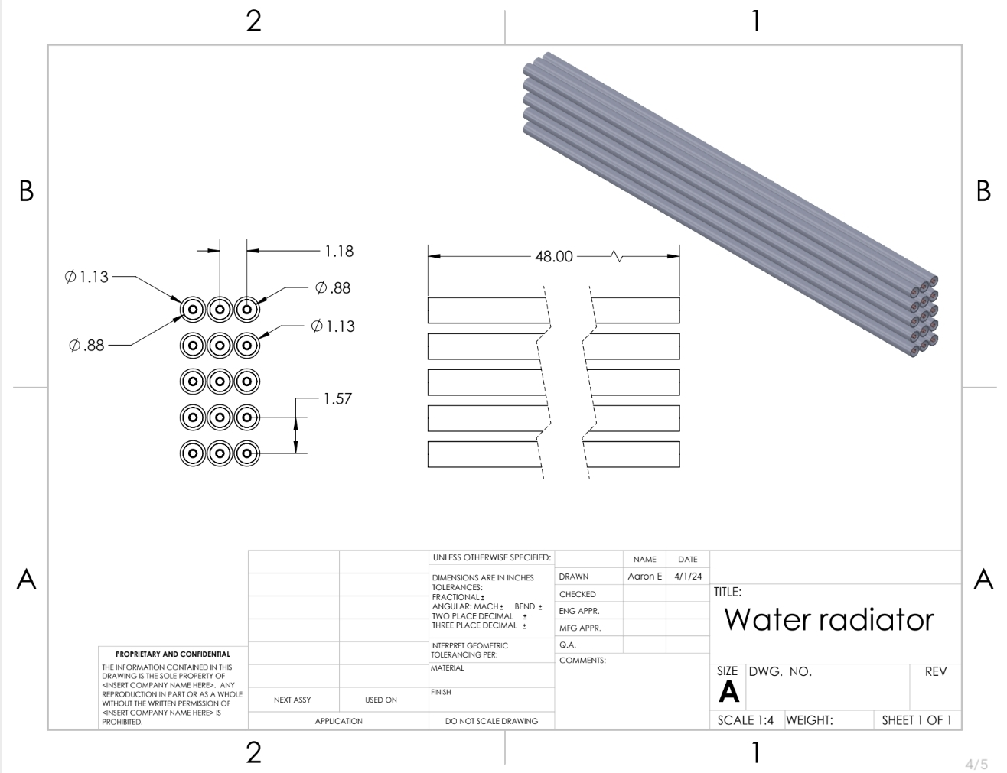
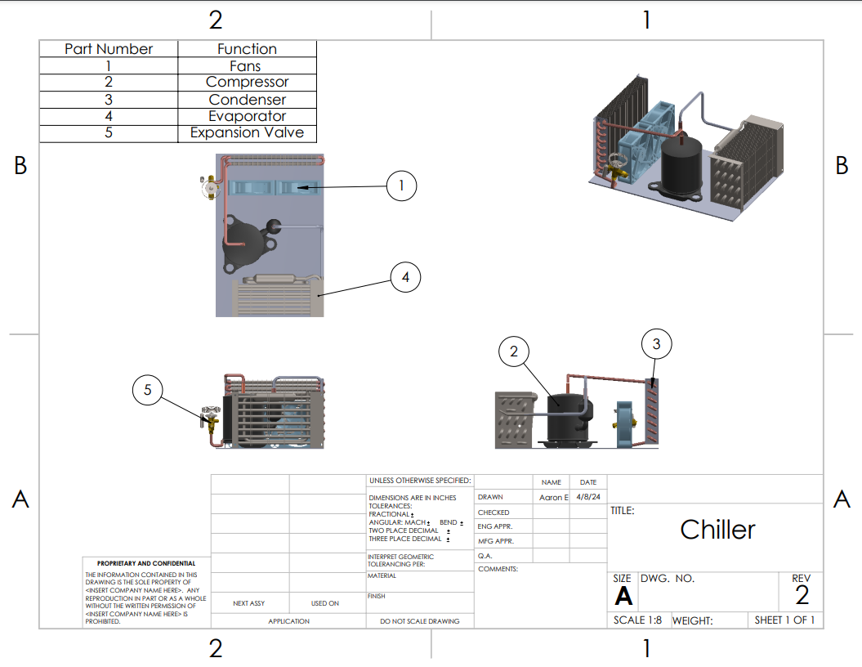
Drawings
3
Aaron
Notes:
Show big than focus on detail, Rough dimensions, we are buying off the shelf of a,b,c,et Talk about pump calcs, They should know about every
There are general HVAC and components, wiring diagram, rated of inputs,
Pump flow rate,

Slide 4
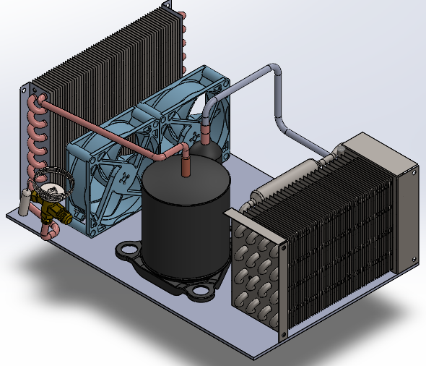
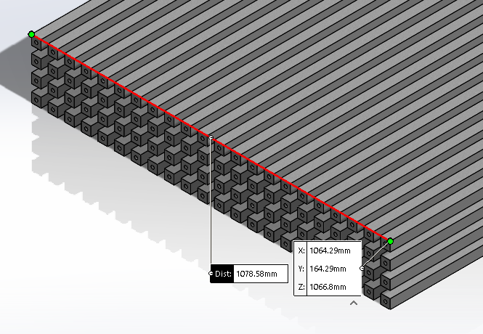
Chiller Methods
4
Steven
Through the Mass
Directly applying refrigerant lines to the thermal mass
Generic Chiller
Notes:
Show the big picture items first (Gen pic) Show rough scale rough dimensions, materials, What does each component do, more detail
Label the different components and simple dimensions
Anything with flowcharts and the cycles
A controller portion

Slide 5
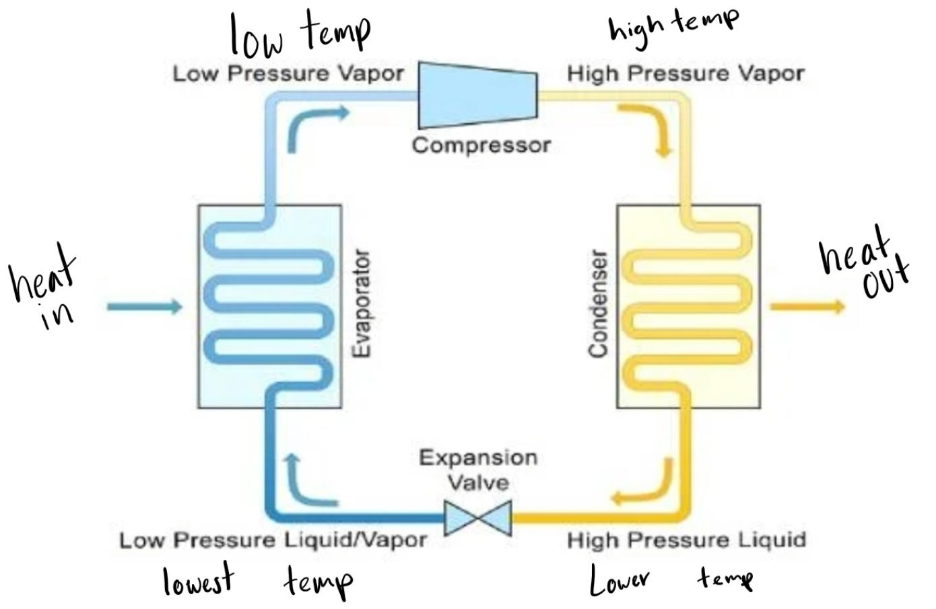
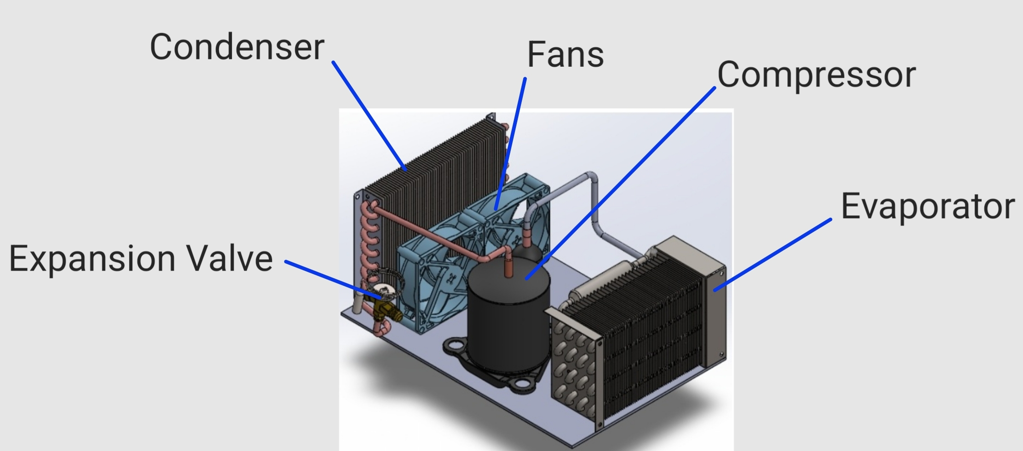
Sub Assembly
5
Aaron

Slide 6
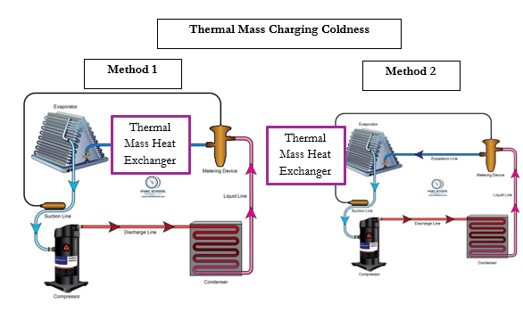
Black Box Model
6
Courtney
Notes:
Inputs outputs, material, charging, each arrow needs to state energy, user vs mechanical, flow, How does this inform a design, both

Slide 7
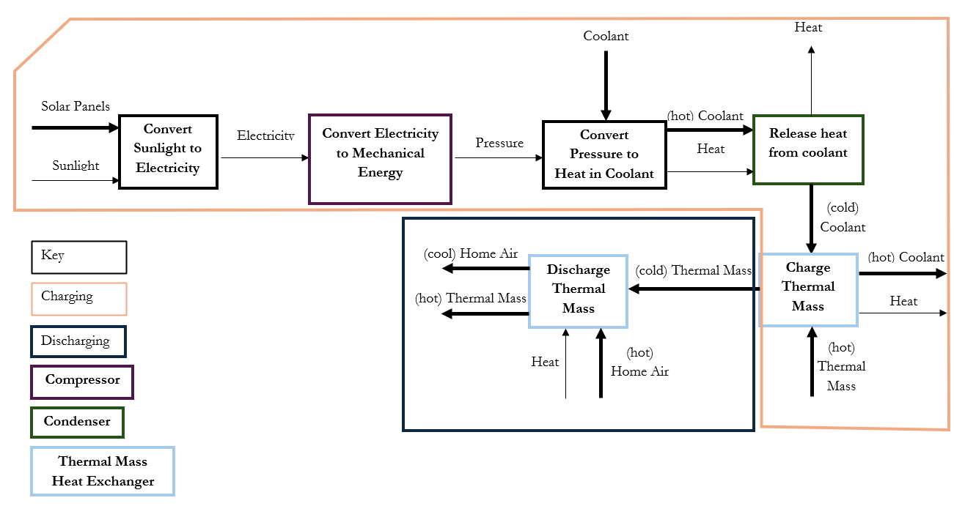
Black Box Model
7
Courtney
Notes:
Inputs outputs, material, charging, each arrow needs to state energy, user vs mechanical, flow, How does this inform a design, both

Slide 8
Top Level Design Function Diagram
8
Steven
Indirect Chiller
Direct Chiller
(HE 1) The Home
(HE 1) The Home
(HTF)
Air from home
Hot
(TM)
Thermal Mass
(HTF)
Air from TM
Hot
(HTF)
Air from home
Hot
(TM)
Thermal Mass
(HTF)
Air from TM
Hot
(HTF)
Ethylene
Cold
(HTF)
Ethylene
Hot
Chiller
(HTF)
refrigerant
Cold
(HTF)
refrigerant
Hot
Liquid Pump
Liquid 2 Liquid
Heat Exchanger
Sub-assembly
(HTF)
Air from outside
Hot
(HTF)
Air from HE 3
Hot
(HE 2)
The heat in the Ethylene Glycol is exchanged into a refrigerant
(HE 3)
The heat in the Refrigerant is exchanged into the outside air
Chiller
(HTF)
refrigerant
Cold
(HTF)
refrigerant
Hot
(HTF)
Air from outside
Hot
(HE 3)
The heat in the refrigerant is exchanged into the outside air
(HTF)
Air from HE 3
Hot
Notes:
Inputs outputs, material, charging, each arrow needs to state energy, user vs mechanical, flow, How does this inform a design, both

Slide 9
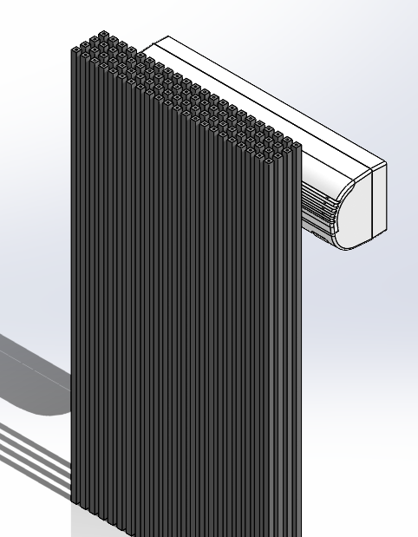
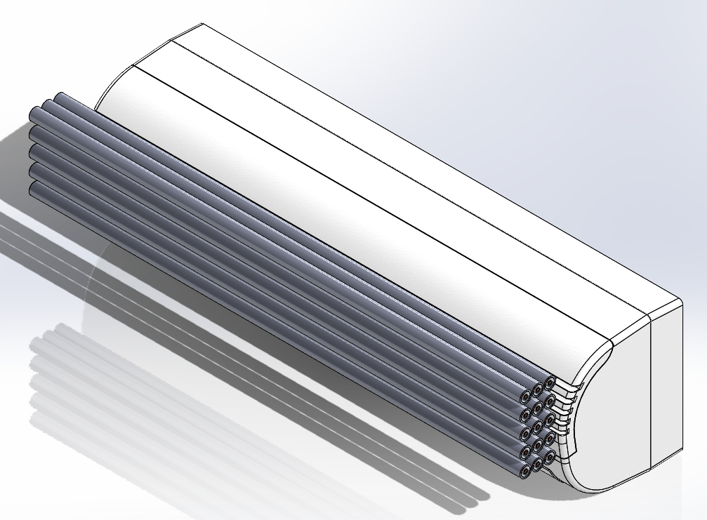
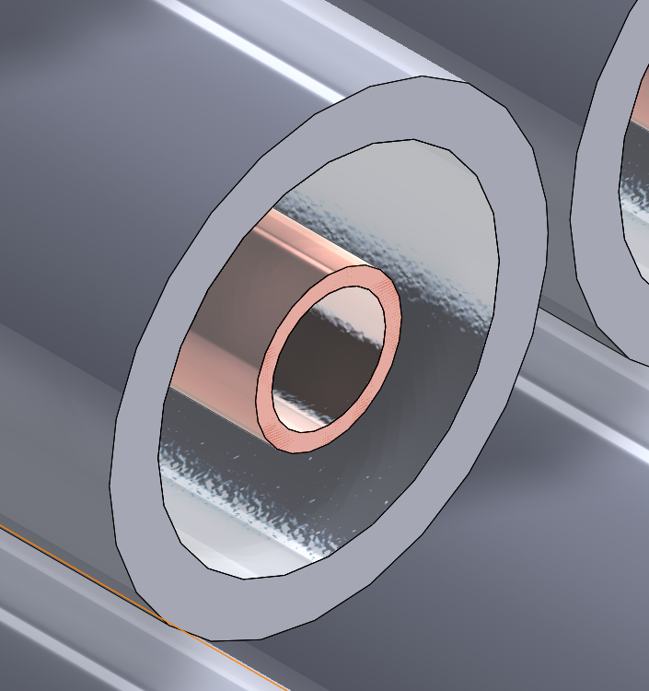
Modes of Operation
9
Aaron
Latent Heat
Water
Container
PEX-A Tube
Copper
Sensible heat
Concrete
Tube
Copper
Notes:
Sequential manner, wire diagrams, detail functionality report

Slide 10
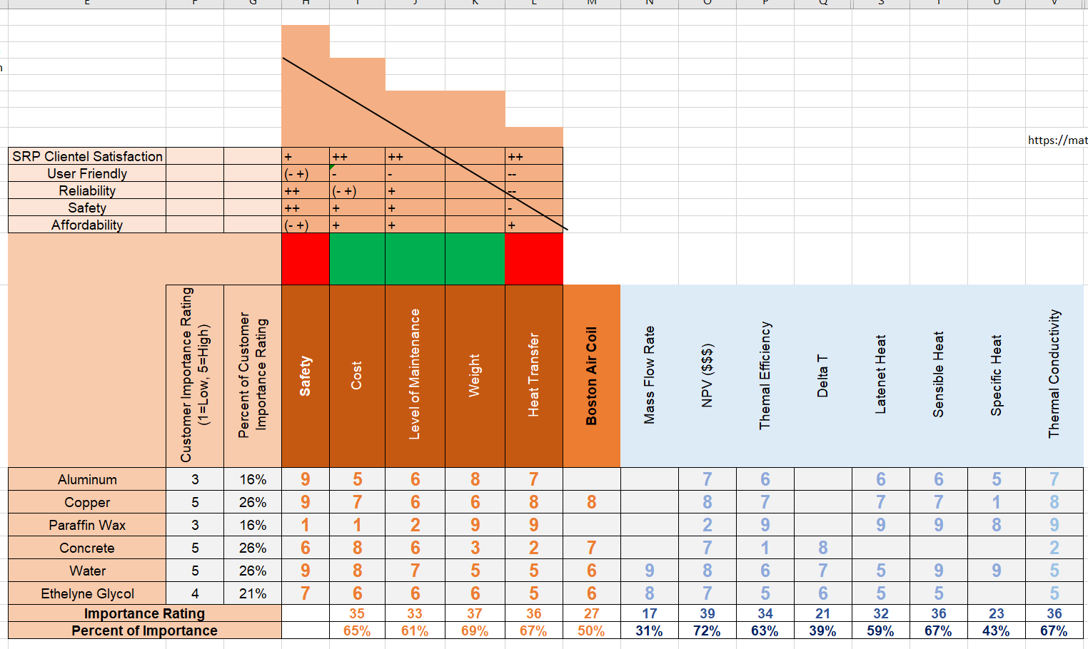
QFD
10
Janelle
Notes:
How does it compare to benchmark, EGR calcs are supposed to match design requirements
Other aspects
Here are all the calcs we have done and these are what we still have to do
FMEA Design Validation, show what is important, put all in appendix
Resources, Solar Shack, Machine shop, access lab room 246 resource library, prototype, Key form, Schedule and Budget, Update,

Slide 11
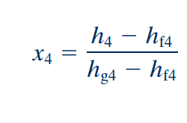
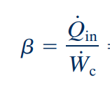
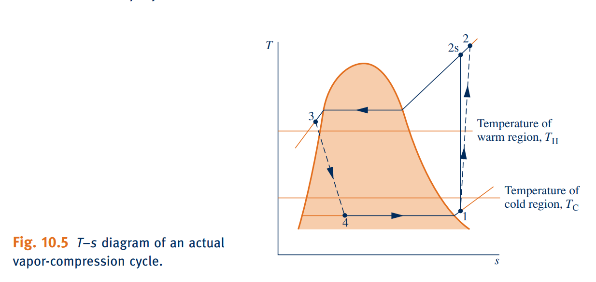
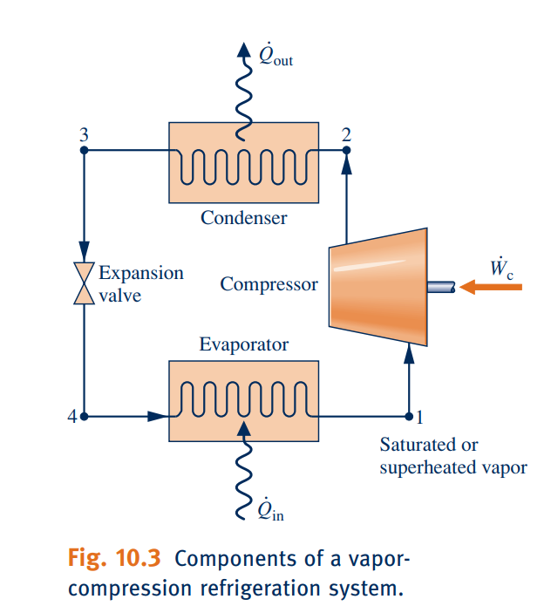
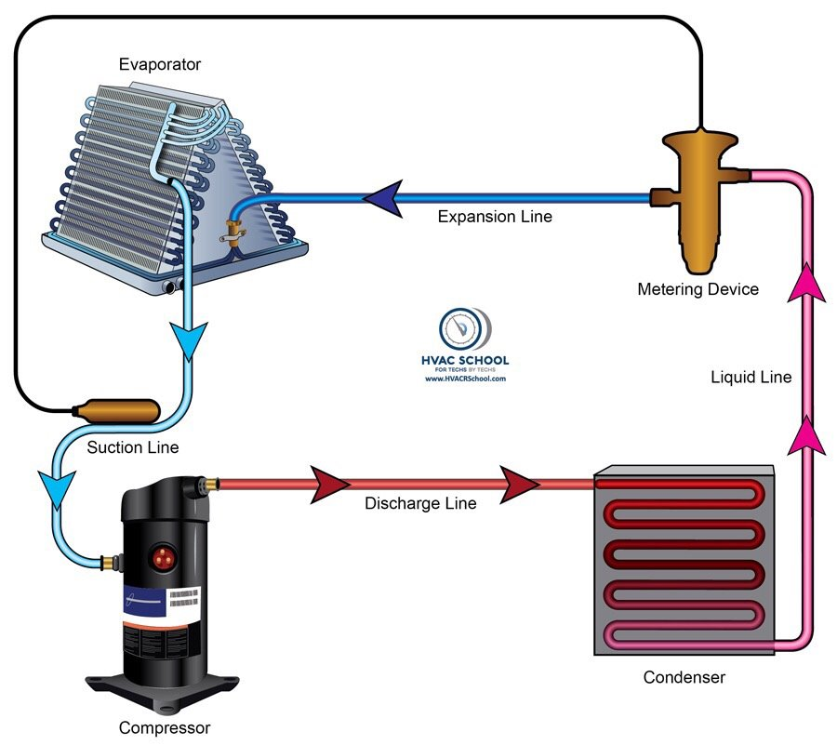
Analyzing an Actual Vapor Compression Refrigeration Cycle
11
Janelle
Quality
Specific entropy
Compressor Power
Refrigeration Capacity
Coefficient of Performance
Exergy Destruction
Isentropic Compressor Efficiency: Assumed an efficiency of 80% to find h2.

Slide 12
MATLAB Engineering Calculations
12
Courtney
function MaterialProperties(HeatofFusion, SpecificHeat, DensityMatrix, MinEnergyRequirement, MaxEnergyRequirement, LowestTemp)
Formula for Sensible and Latent Heat
Q = Thermal Energy Stored
m = Mass
Cp = Specific Heat
T = Temperature
F = Heat of Fusion (constant)
D = Density
$$Q=mCp∆T+mF$$
Rearranged to Solve for Mass
m=Q/(Cp$∆$T+F)
Convert Mass to Volume
V = m/d

Slide 13
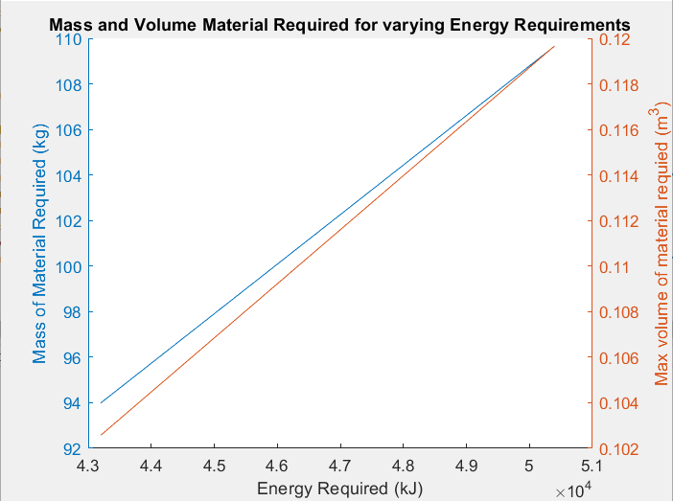
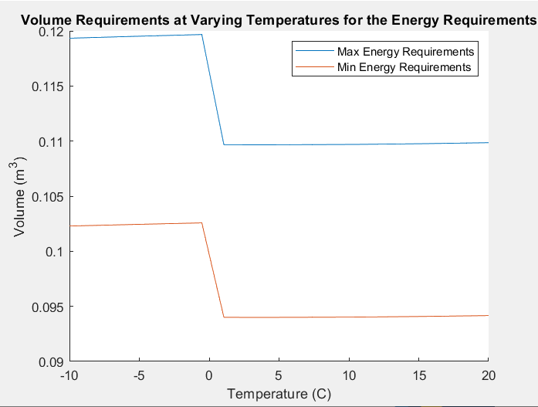
MATLAB Material Analysis - Water
13
Courtney

Slide 14
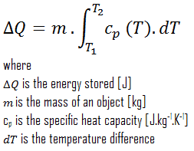
Material Analysis - Concrete
14
Steven
The amount of heat storage for concrete is differential.
The temperature difference of the heat transfer fluid determines the capacity.
Structural temperature is relatively constant
Specific heat concrete ranges from 084 to 1.17 $\frac{KJ}{Kg}$
In the case of concrete, the required mass is decreased if the heat transfer fluid is greatly chilled
$$mass=\frac{Q}{ΔT ∗Cp}$$

Slide 15
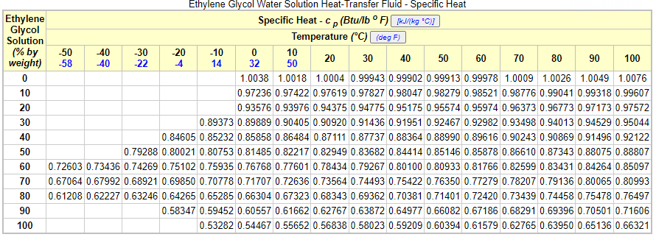
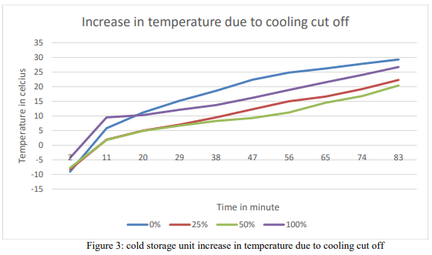
Material Analysis – Ethylene Glycol
15
Steven
Heat Transfer Fluids are the third rail of this project.
As a heat transfer fluid (HTF), ethylene is cost-effective.
Ethylene latent heat of fusion is half that of water (159.5 $\frac{KJ}{Kg}$ )
Mixtures show advanced storage characteristics requiring benefit analysis versus health safety risk.
https://www.engineeringtoolbox.com/ethylene-glycol-d_146.html
https://iopscience.iop.org/article/10.1088/1757-899X/377/1/012190/pdf

Slide 16
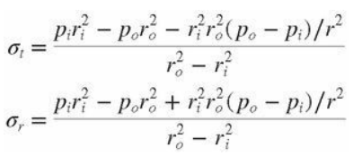
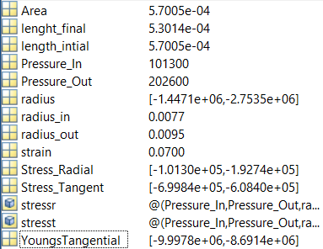
FMEA
16
Steven
Failure Mode and Effects Analysis
Failure modes are listed and imagined for all possible failures. Here, the mode of highest risk is ice expansion in the casing. Pex A is designed to expand at the same rate as the water. The freezing effect will risk the copper line being crushed.
Young’s Modulus of copper is between 110 and 130 GPA. Here, the average is used because it will inform our fatigue and thermal stress calculations for future FMEA.

Slide 17
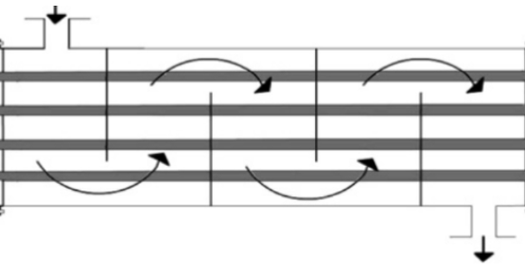
Testing Procedures
17
Maciej
Fluid Inlet
Measurments:
K-Type Thermocouple #1
$$Change in Temperature: ∆T$$
PCM
$$Enthalpy:h$$
$$Volumetric Flow Rate:Q$$
K-Type Thermocouple #2
Fluid Outlet
Calculations:
Equipment | K-Type Thermocouple Cooling Fluid Phase Change Material Control Volume Tube/Tank for Cooling Fluid Closed System Tube/Pipe for PCM
Resources | Mechanical Measurements Book
Space | Thermal Fluids Lab
$$Q=mc∆T+mF$$
$$∆h=∆U+PV$$

Slide 18
Net Present Value (NPV)
18
Maciej
Present sum of money in contrast to future value it will have when it has been invested
Price per unit
Copper | 0.52 | ft
Concrete | 5.56 | gal
Water | 0.45 | gal
Glycol | 13.47 | gal
PEX-A | 0.61635 | ft
Aluminium | 0.6556 | ft
Project: |  | Net Present Value
Thermal Energy Storage | $1,029.72
Period | Cash Flow | PV | Total
1 | $374.36 | $359.96 | $359.96
2 | $374.36 | $346.12 | $706.08
3 | $374.36 | $332.80 | $1,038.88
4 | $374.36 | $320.00 | $1,358.89
5 | $374.36 | $307.70 | $1,666.58
6 | $374.36 | $295.86 | $1,962.45
7 | $374.36 | $284.48 | $2,246.93
8 | $374.36 | $273.54 | $2,520.47
9 | $374.36 | $263.02 | $2,783.49
10 | $374.36 | $252.90 | $3,036.40
Annual Rate | 0.04
Initial Investment | $2,006.68
Initial Investment Water with pump replacement
Pump | $339.78 | unit
Water | $11.86 | 40 gal
Copper | $800.00 | 1200ft
PEX-A | $739.00 | 1200ft
Heat Exchanger | $60.00 | unit
Glycol | $56.04 | 4.16gal
Total | $2,006.68
Initial Investment Water w/ chiller
Chiller | $3,000.00 | unit
Water | $11.86 | 40 gal
Copper | $800.00 | 1200ft
PEX-A | $739.00 | 1200ft
Glycol | $56.04 | 4.16gal
Total | $4,606.90

Slide 19
Project Budget
19
Maciej
Bill of Materials
Item | Category | Description | Quantity | Cost
Calcium Chloride Hexahydrate | Material | PCM for prototype testing | 0.5kg | $104.64
Magnesium Chloride Hexahydrate | Material | PCM for prototype testing | 1kg | $58.36
Ethylene Glycole | Material | Fluid to cool down the PCM | 1Gal | $15.05
Distilled Water | Material | Fluid to cool down the PCM | 1Gal | $1.29
4 OD inch ABS Pipe | Part | Main Body of HX | 1 | $61.10
1/8 OD inch Copper Tube | Part | PCM Storage | 16 | $45.10
Copper Cap | Part | PCM Storage | 32 | $41.80
ABS Cap | Part | Main Body of HX | 2 | $45.77
Estimated Cost: $ 331.31
Funds
Salt River Project (SRP) | $5,000
Fundraising | $500
Summary
Funds | $5,500
Costs | $ 331.31
Remaining Budget | $ 5168.69

Slide 20
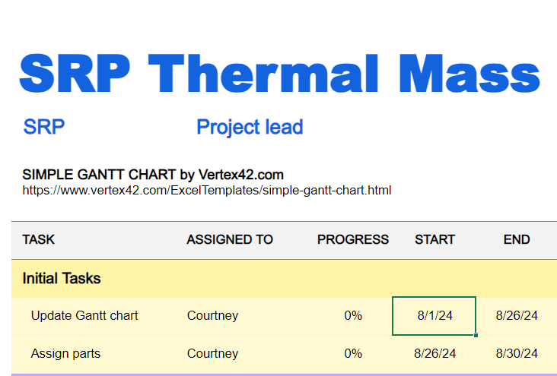
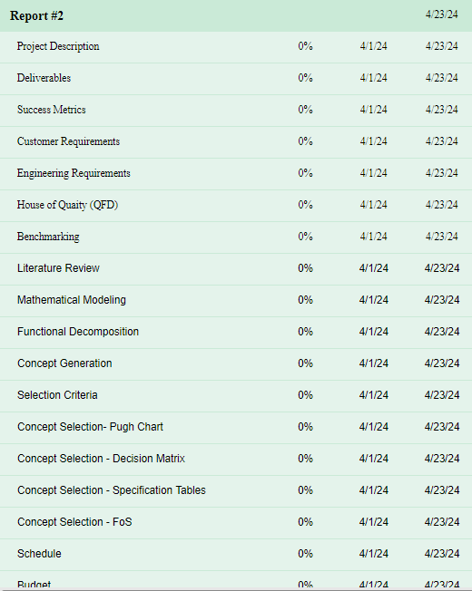
Schedule for Next Semester
20
Courtney
Notes:
Need to highlight future work, outlying major deadlines, major components, Tom is Flexible we don’t have hard deadlines, are things going to be done this summer, by end of semester, Poster Website, 100% build, 33% build is due near beginning of the semester, Ask Acker about testing, what happens at the end, present, what happens when it is fully built,
We can test and collect data over the summer

Slide 21
Thank you!
Page number
Notes:
Janelle Conclusion
Like so many projects before, the end is just the beginning. This hydro-plant has the ability to change the lives of people on the navajo reservation. When this project is completed, our project might be done but their opportunities have just begun. Thank you for your time we hope you have enjoyed our presentation.

Slide 22
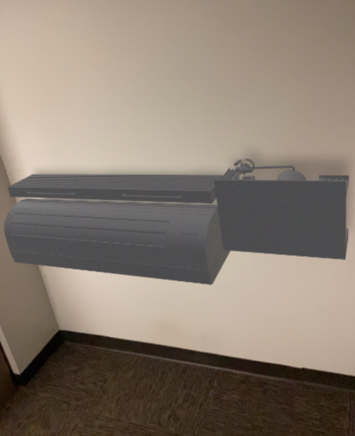
AR
22
Courtney

Slide 23
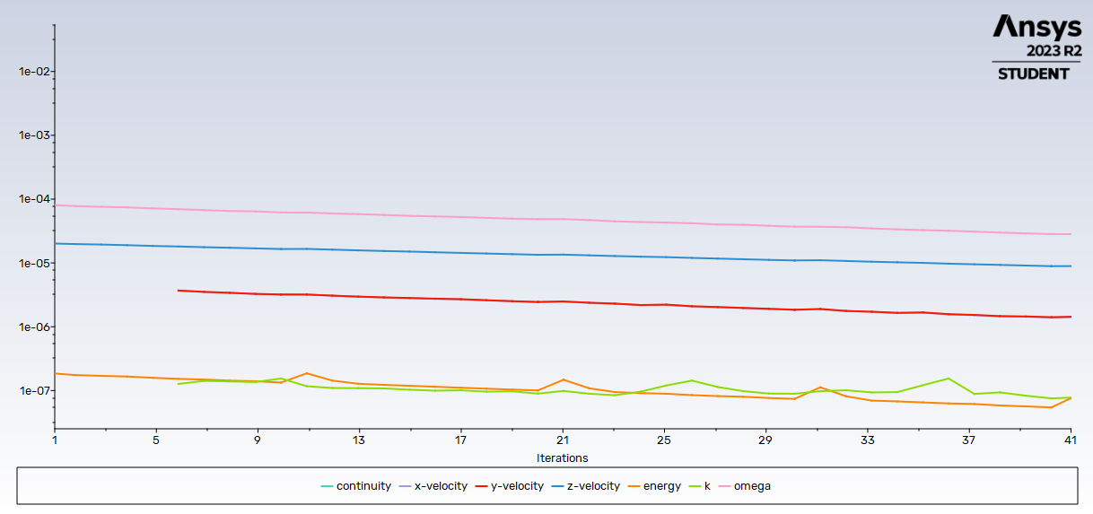
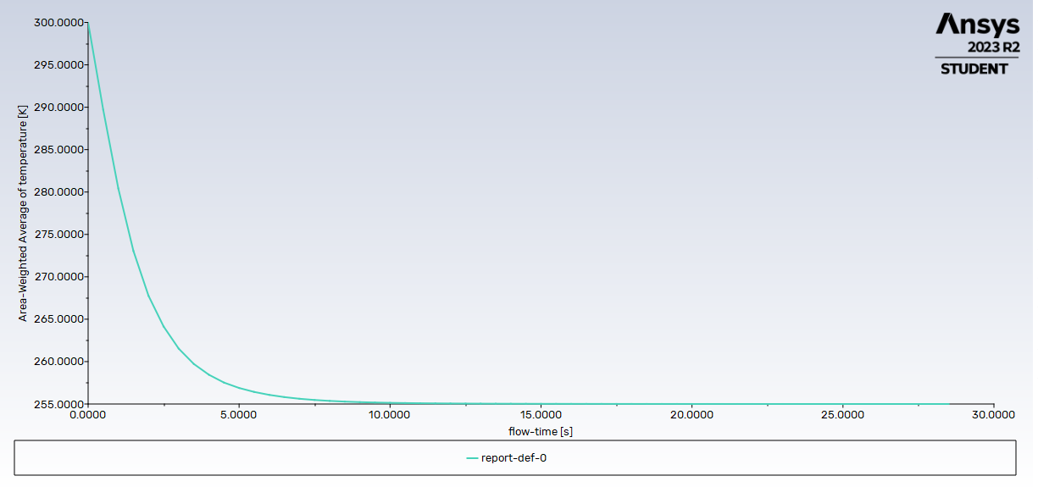
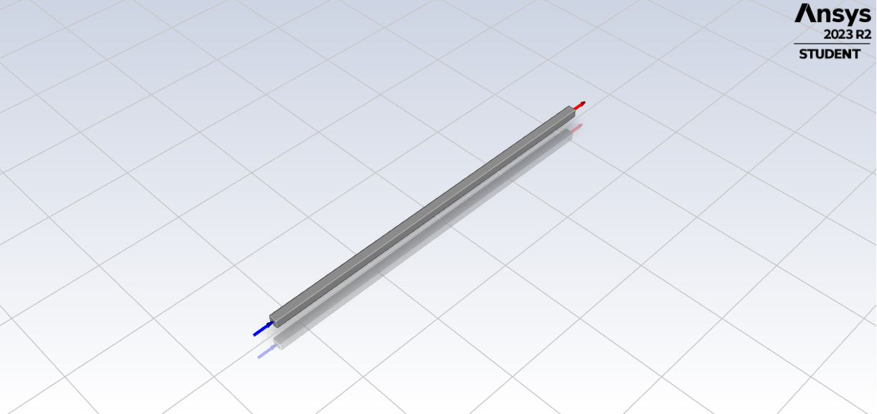
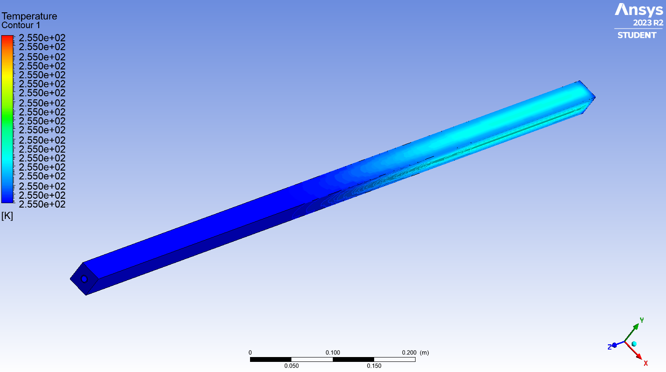
Ansys - Concrete
23
Steven

Slide 24
References
Page number
[1] “Cold Storage - Viking Cold SolutionsTM.” Accessed: Feb. 05, 2024. [Online]. Available: https://www.vikingcold.com/cold-storage/
[2]“TSU-M ICE CHILLER® Thermal Storage Unit | Baltimore Aircoil.” Accessed: Feb. 05, 2024. [Online]. Available: https://baltimoreaircoil.com/products/ice-thermal-storage/tsu-m-ice-chiller-thermal-storage-unit
[3]“Thermal Energy Storage for Chilled Water Systems,” VERTEX. Accessed: Feb. 05, 2024. [Online]. Available: https://vertexeng.com/insights/thermal-energy-storage-for-chilled-water-systems/
[4]“Thermal Energy Storage,” Energy.gov. Accessed: Feb. 04, 2024. [Online]. Available: https://www.energy.gov/eere/buildings/thermal-energy-storage
[5]“Ice Storage or Chilled Water Storage? Which Is Right for the Job? | Chiller & Cooling Best Practices.” Accessed: Feb. 05, 2024. [Online]. Available: https://coolingbestpractices.com/system-assessments/chillers/ice-storage-or-chilled-water-storage-which-right-job
[6]https://mts.intechopen.com/storage/books/10216/authors_book/authors_book.pdf.
[7]“Economic Analysis of a Novel Thermal Energy Storage System Using Solid Particles for Grid Electricity Storage,” Accessed: Feb. 01, 2024. [Online]. Available: https://permanent.fdlp.gov/gpo173230/79014.pdf
[8]“Chilled Water Storage | Ice Thermal Storage, District Energy | FVB Energy Inc,” FVB Energy Inc. Accessed: Feb. 05, 2024. [Online]. Available: https://fvbenergy.com/district-energy-expertise/thermal-energy-storage/chilled-waterice-storage/
[9]
[10]T. Yang, W. P. King, and N. Miljkovic, “Phase change material-based thermal energy storage,” Cell Reports Physical Science, vol. 2, no. 8, p. 100540, Aug. 2021, doi: 10.1016/j.xcrp.2021.100540.
[11]M. Yamaha and S. Misaki, “The Evaluation of Peak Shaving by a Thermal Storage System Using Phase-Change Materials in Air Distribution Systems,” HVAC&R Research, vol. 12, no. sup3, pp. 861–869, Sep. 2006, doi: 10.1080/10789669.2006.10391213.
[12]C. Veerakumar and A. Sreekumar, “Phase change material based cold thermal energy storage: Materials, techniques and applications – A review,” International Journal of Refrigeration, vol. 67, pp. 271–289, Jul. 2016, doi: 10.1016/j.ijrefrig.2015.12.005.
[13]A. Palacios, L. Cong, M. E. Navarro, Y. Ding, and C. Barreneche, “Thermal conductivity measurement techniques for characterizing thermal energy storage materials – A review,” Renewable and Sustainable Energy Reviews, vol. 108, pp. 32–52, Jul. 2019, doi: 10.1016/j.rser.2019.03.020.
[14]M. Morgan, H. Shapiro, D. Boettner, and M. Bailey, Fundamentals of Engineering Thermodynamics. John Wiley & Sons, Inc., 2014.
[15]T. Kuczyński and A. Staszczuk, “Experimental study of the influence of thermal mass on thermal comfort and cooling energy demand in residential buildings,” Energy, vol. 195, p. 116984, Mar. 2020, doi: 10.1016/j.energy.2020.116984.

Slide 25
References
Page number
[16]A. Hesaraki, S. Holmberg, and F. Haghighat, “Seasonal thermal energy storage with heat pumps and low temperatures in building projects—A comparative review,” Renewable and Sustainable Energy Reviews, vol. 43, pp. 1199–1213, Mar. 2015, doi: 10.1016/j.rser.2014.12.002.
[17]A. Erek, Z. ?Lken, and M. A. Acar, “Experimental and numerical investigation of thermal energy storage with a finned tube,” Int. J. Energy Res., vol. 29, no. 4, pp. 283–301, Mar. 2005, doi: 10.1002/er.1057.
[18]Z. ElSayed and A. Dhmees, Paraffin: Thermal Energy Storage APplications. Accessed: Feb. 01, 2024. [Online]. Available: https://mts.intechopen.com/storage/books/10216/authors_book/authors_book.pdf
[19]M. F. Demirbas, “Thermal Energy Storage and Phase Change Materials: An Overview,” Energy Sources, Part B: Economics, Planning, and Policy, vol. 1, no. 1, pp. 85–95, Jan. 2006, doi: 10.1080/009083190881481.
[20]L. F. Cabeza, Ed., “Title page,” in Advances in Thermal Energy Storage Systems (Second Edition), in Woodhead Publishing Series in Energy. , Woodhead Publishing, 2021, pp. i–iii. doi: 10.1016/B978-0-12-819885-8.00030-9.
[21]L. F. Cabeza, Ed., “Copyright,” in Advances in Thermal Energy Storage Systems (Second Edition), in Woodhead Publishing Series in Energy. , Woodhead Publishing, 2021, p. iv. doi: 10.1016/B978-0-12-819885-8.00031-0.
[22]L. Cabeza, Advances in Thermal Energy Energy Storage Systems. 2020.
[23]T. L. Bergman, A. S. Lavine, F. P. Incropera, and D. P. DeWitt, Fundamentals of Heat and Mass Transfer, 8th ed. John Wiley & Sons, Inc., 2017.
[24]J. R. Balikowski and J. C. Mollendorf, “Performance of Phase Change Materials in a Horizontal Annulus of a Double-Pipe Heat Exchanger in a Water-Circulating Loop,” Journal of Heat Transfer, vol. 129, no. 3, pp. 265–272, Mar. 2007, doi: 10.1115/1.2426359.
[25]R. Al-Shannaq et al., “List of Contributors,” in Advances in Thermal Energy Storage Systems (Second Edition), L. F. Cabeza, Ed., in Woodhead Publishing Series in Energy. , Woodhead Publishing, 2021, pp. xix–xxii. doi: 10.1016/B978-0-12-819885-8.00033-4.
[26]A. A. Al-Abidi, S. Bin Mat, K. Sopian, M. Y. Sulaiman, C. H. Lim, and A. Th, “Review of thermal energy storage for air conditioning systems,” Renewable and Sustainable Energy Reviews, vol. 16, no. 8, pp. 5802–5819, Oct. 2012, doi: 10.1016/j.rser.2012.05.030.
[27]P. Scheuerpflug, M. Hauck, and J. Fricke, “Thermal properties of silica aerogels between 1.4 and 330 K,” Journal of Non-Crystalline Solids, vol. 145, pp. 196–201, Jan. 1992, doi: 10.1016/S0022-3093(05)80455-7.
[28]“PCM Products.” Accessed: Feb. 22, 2024. [Online]. Available: https://www.pcmproducts.net/
[29]“Table 1 Thermal properties of concrete.,” ResearchGate. Accessed: Feb. 04, 2024. [Online]. Available: https://www.researchgate.net/figure/Thermal-properties-of-concrete_tbl1_240638344
[30} “SRP Time-of-Use (TOU) Price Plan | SRP.” Accessed: Feb. 03, 2024. [Online]. Available: https://www.srpnet.com/price-plans/residential-electric/time-of-use
[31]b“Our Company | Baltimore Aircoil Company.” Accessed: Feb. 05, 2024. [Online]. Available: https://baltimoreaircoil.com/about
[32] “Natural Gas Generator Efficiency & Approximate Consumption Chart.” Accessed: Feb. 03, 2024. [Online]. Available: https://devgeneratorsource.bluemod.us/Natural_Gas_Fuel_Consumption.aspx
[33] “Hourly electricity consumption varies throughout the day and across seasons - U.S. Energy Information Administration (EIA).” Accessed: Feb. 03, 2024. [Online]. Available: https://www.eia.gov/todayinenergy/detail.php?id=42915
[34] “Energy density - Energy Education.” Accessed: Feb. 03, 2024. [Online]. Available: https://energyeducation.ca/encyclopedia/Energy_density
[35] “Arizona Price of Natural Gas Delivered to Residential Consumers (Dollars per Thousand Cubic Feet).” Accessed: Feb. 03, 2024. [Online]. Available: https://www.eia.gov/dnav/ng/hist/n3010az3m.htm
[36] C. K. Ho and A. Ambrosini, “CHAPTER 12 THERMAL ENERGY STORAGE TECHNOLOGIES,” Thermal Energy Storage.

